Slide 1
Workshop on
Virtual Laboratory
CircuitVerse

Slide 2
Experiments to be performed using Virtual Laboratory:
8 bit Comparator
SR- Flip flop
1 | Digital Logic Design Lab | https://dld-iitb.vlabs.ac.in/exp/eight-bit-digital-comparator/simulation.html
2 | Digital Electronics 1 | https://de-iitr.vlabs.ac.in/exp/truth-tables-flip-flops/simulation.html

Slide 3
As per the new procedure set up by IITB VLAB Nodal Center(SVU-10) a planner sheet for the usage of VLAB is shared.
Conducting the experiment given through the link in planner, students have to fill up the feedback through a separate link provided for feedback.
Use In-House feedback using Somaiya email Id.
Then only the feedback is registered and its report is generated which is important for our college to be a nodal centre of VLAB.
( https://iitb.vlabs.co.in/outreachportal/ )

Slide 4
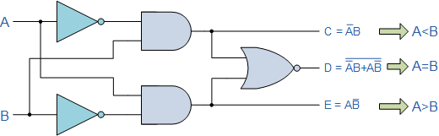
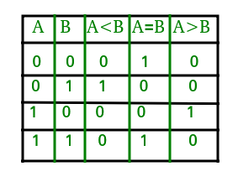
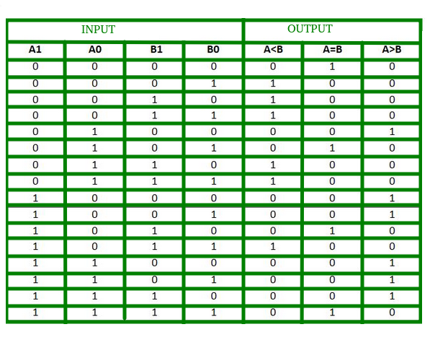
1 Bit Comparator
2 Bit Comparator

Slide 5
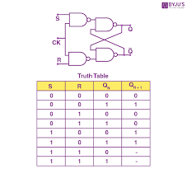
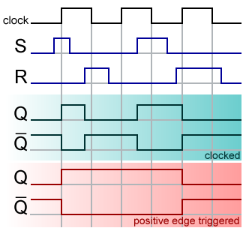

Slide 6
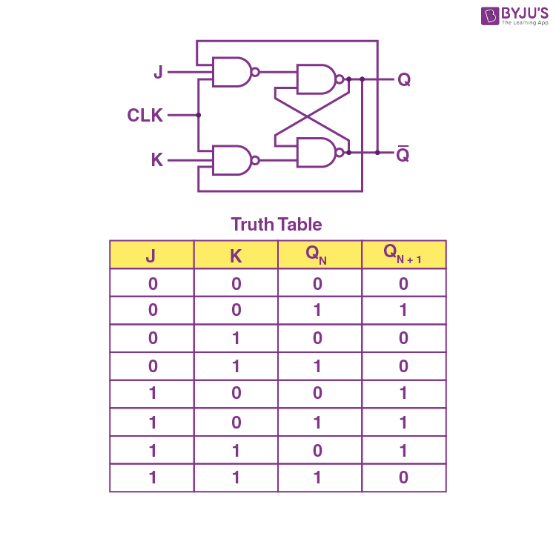

Slide 7
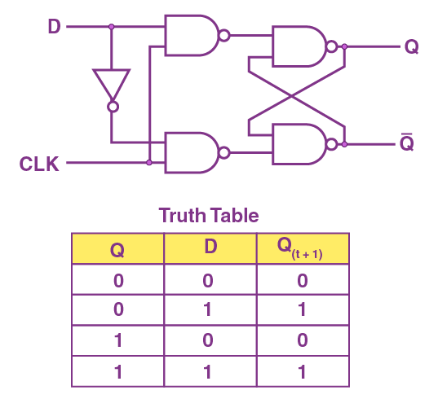

Slide 8
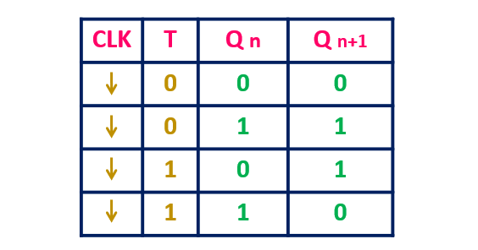
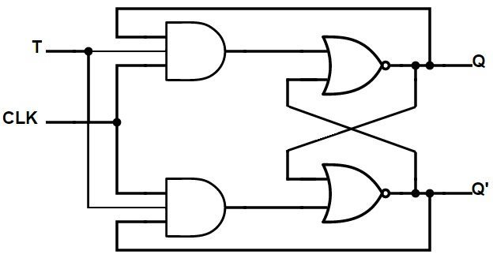

Slide 9
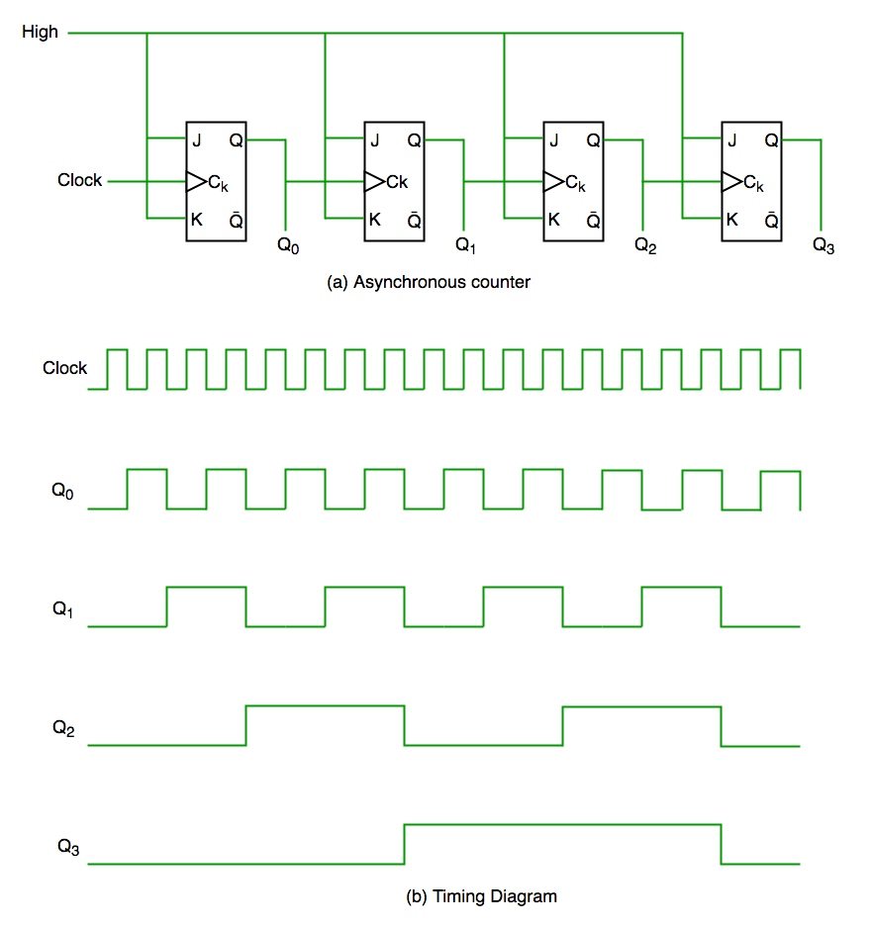
There are two types of counters in digital logic circuit that are used to count the numbers of bits and these types depends upon the clock pulse applied to the flip flops.
1. Asynchronous Counter:
These are the counters in which we do not use universal clock, main clock is only applied to the first flip flop(LSB) and then for rest of flip flops the output of previous flip flop is taken as a clock.

Slide 10
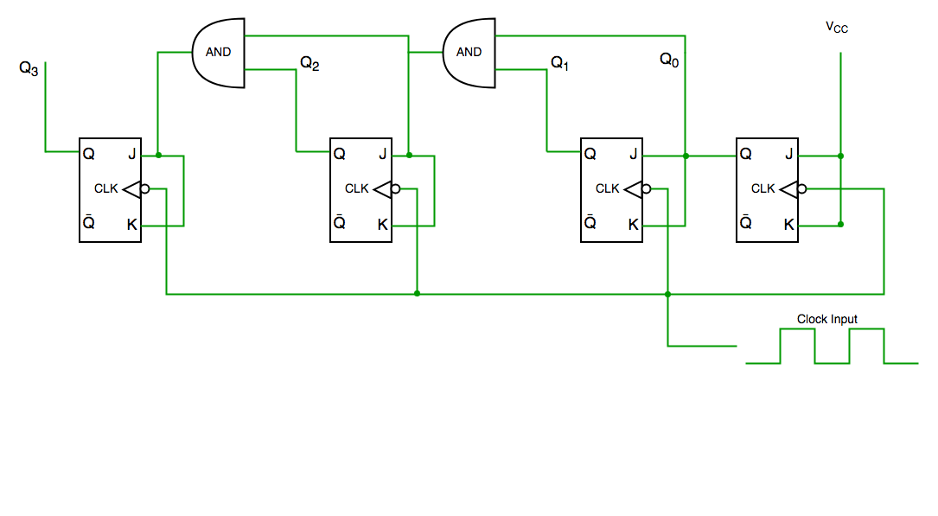
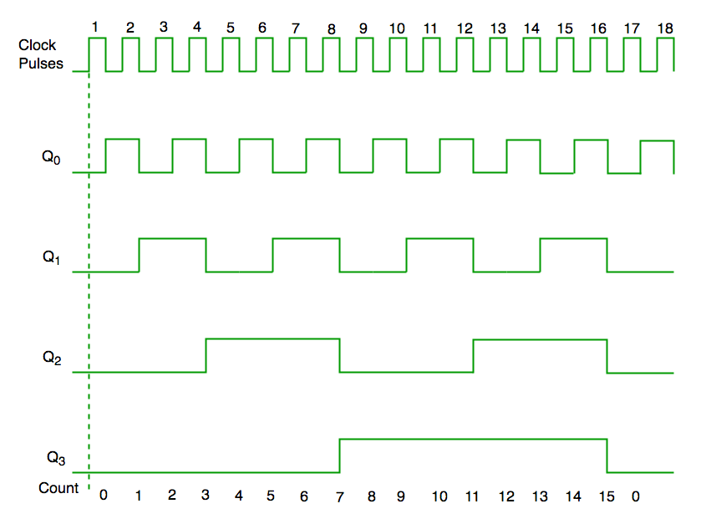
Synchronous Counter:
These are the counters in which we use a universal clock that is common to all flip-flops. The Circuit diagram of the Synchronous Counter is given Below:
From the circuit diagram, we see that the Q0 bit gives a response to each falling edge of a clock while Q1 is dependent on Q0, Q2 is dependent on Q1 and Q0, and Q3 is dependent on Q2, Q1 and Q0.

Slide 11
What is a Ripple counter?
is a cascaded arrangement of flip-flops where the output of one flip-flop drives the clock input of the following flip-flop.
The number of flip flops in the cascaded arrangement depends upon the number of different logic states that it goes through before it repeats the sequence a parameter known as the modulus of the counter.
A n-bit ripple counter can count up to 2^{n} states. It is also known as MOD n counter. It is known as ripple counter because of the way the clock pulse ripples its way through the flip-flops.
Some of the features of ripple counter are:
It is an asynchronous counter.
Different flip-flops are used with a different clock pulse.
All the flip-flops are used in toggle mode.
Only one flip-flop is applied with an external clock pulse and another flip-flop clock is obtained from the output of the previous flip-flop.
The flip-flop applied with an external clock pulse act as LSB (Least Significant Bit) in the counting sequence.

Slide 12
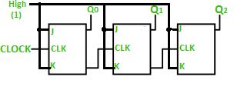
A 3-bit Ripple counter using a JK flip-flop is as follows:

Slide 13
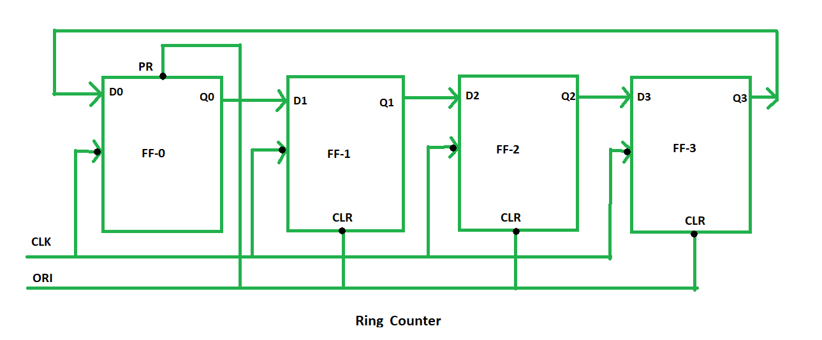
A ring counter is a typical application of the Shift register.
The only change is that the output of the last flip-flop is connected to the input of the first flip-flop in the case of the ring counter but in the case of the shift register it is taken as output.
Except for this, all the other things are the same.
No. of states in Ring counter = No. of flip-flop used
So, for designing a 4-bit Ring counter we need 4 flip-flops.

Slide 14
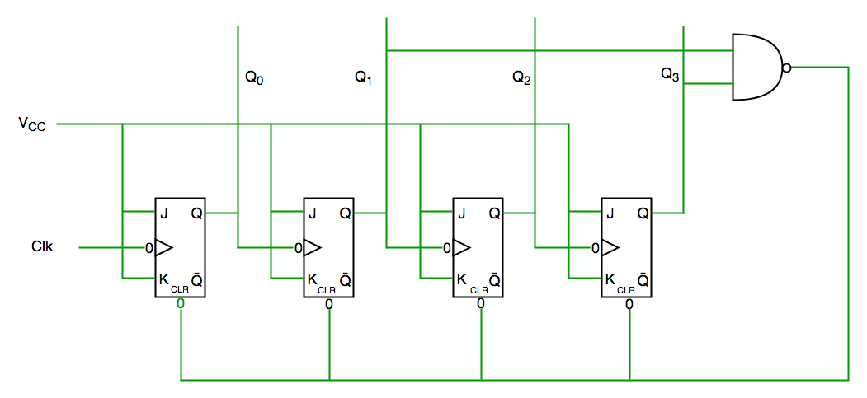
A decade counter counts ten different states and then reset to its initial states. A simple decade counter will count from 0 to 9 but we can also make the decade counters which can go through any ten states between 0 to 15(for 4 bit counter).
Decade Counter
We see from the circuit diagram that we have used the NAND gate for Q3 and Q1 and feeding this to clear the input line because the binary representation of 10 is— 1010
And we see Q3 and Q1 are 1 here, if we give NAND of these two bits to clear input then the counter will be clear at 10 and again start from the beginning.
Important point: The number of flip flops used in the counter are always greater than equal to (log2 n) where n=number of states in the counter.

Slide 15
Sr. No. | Synchronous Counter | Asynchronous Counter
1 | In synchronous counter we use a universal clock that is common to all flip flops throughout the circuit. | In asynchronous counter main clock is only applied to the first flip flop and then for rest of flip flops the output of previous flip flop is taken as a clock.
2 | Synchronous Counter is faster in operation as compared to Asynchronous Counter. | Asynchronous Counter is slower as compared to synchronous counter in operation.
3 | Synchronous Counter does not produce any decoding errors. | Asynchronous Counter produces decoding error.
4 | Synchronous Counter is also called Parallel Counter. | Asynchronous Counter is also called Serial Counter.
5 | Synchronous Counter designing as well implementation are complex due to increasing the number of states. | Asynchronous Counter designing as well as implementation is very easy.
6 | Synchronous Counter will operate in any desired count sequence. | Asynchronous Counter will operate only in fixed count sequence (UP/DOWN).
7 | Synchronous Counter examples are: Ring counter, Johnson counter. | Asynchronous Counter examples are: Ripple UP counter, Ripple DOWN counter.
8 | In synchronous counter, propagation delay is less. | In asynchronous counter, there is high propagation delay.

